Slide 1
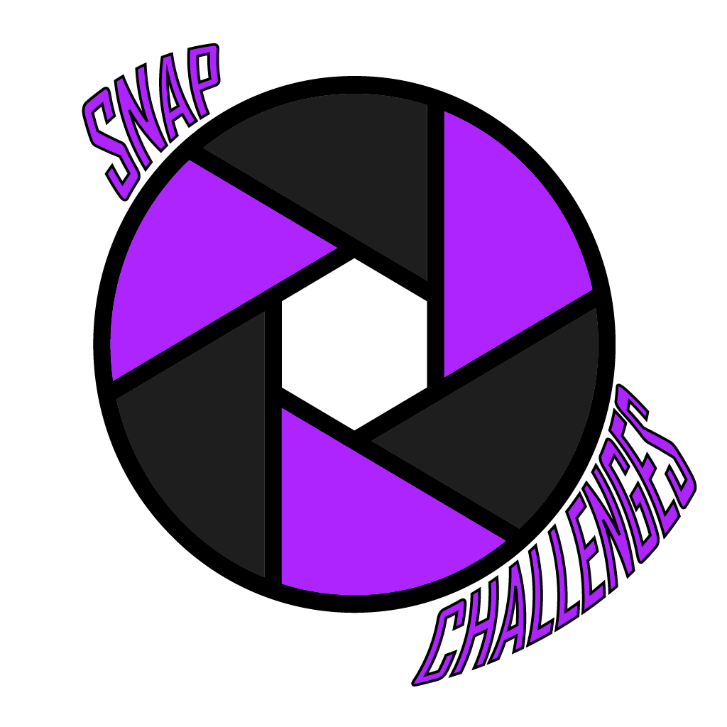

Slide 2
AIMS
To develop a platform independent app to gamify photography via the use of challenges.
To minimise burn out amongst photographers using these challenges to engage them with the app and their hobby.
To educate the users of the app by providing information about the camera settings used to achieve the resulting photo.

Slide 3
Objectives
Research gamification benefits and drawbacks, and other times it has been used in the photography field.
Research React Native in comparison to Progressive Web Apps (PWAs).
Research data storage solutions MYSQL vs NOSQL.
Design and develop the database-schema.
Design and develop the Flask API.
Design and develop the front-end client as either a React Native app or PWA.
Test the system.
Produce a report to summarise findings, research, implementation, and testing stages of development.

Slide 4
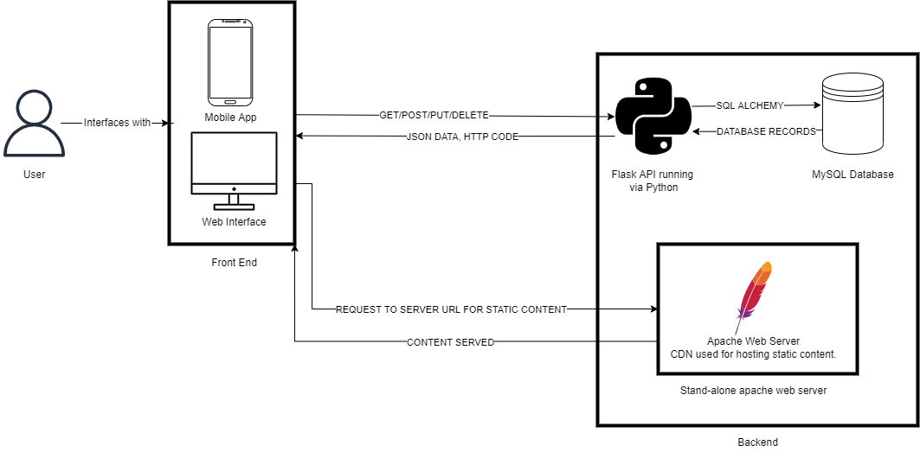
System Architecture

Slide 5
DEMO

